Slide 1
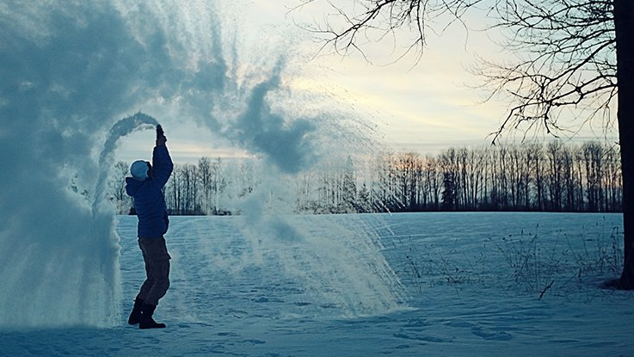
Does hot water freeze faster?
By: Maninder Dhanauta

Slide 2
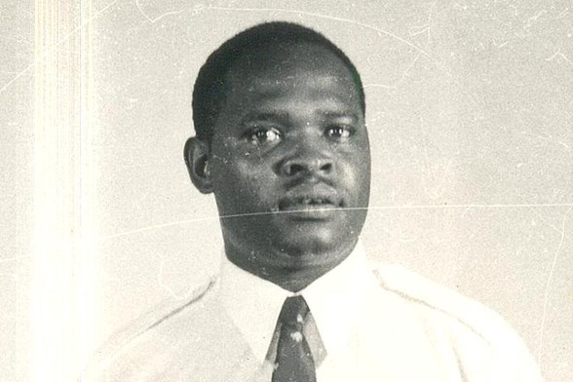
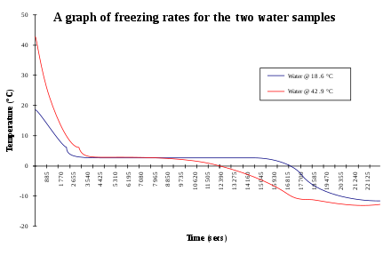
Justification for Topic
Mpemba Effect is a real phenomenon.
States:
“There exists a set of initial parameters, and a pair of temperatures, such that given two bodies of water identical in these parameters, and differing only in initial uniform temperatures, the hot one will freeze sooner.”

Slide 3
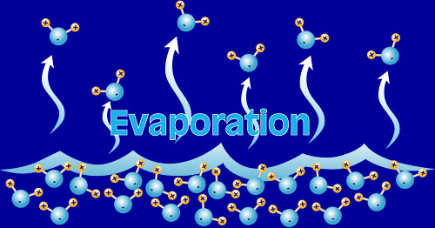

Problem
Thesis:
Is there a relation between the initial temperature of water and the time it takes the sample to reach freezing?
Sub Questions:
Effect of impurities on the TTF.
Significance of water loss.
Exploring the paradoxical nature of the effect

Slide 4

Hypothesis
Warmer water will take longer to freeze
Distilled > Tap
Population: Every temperature from 0°C to 100 °C
Sample: Every 5th degree starting from 10°C to 90°C

Slide 5
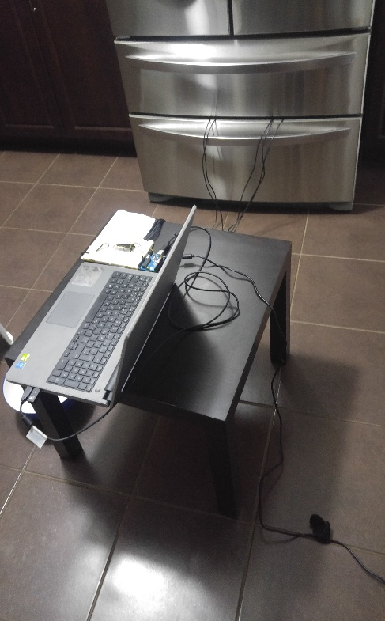
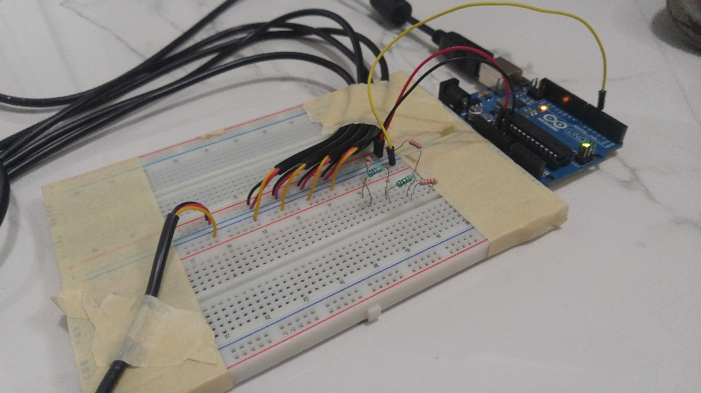
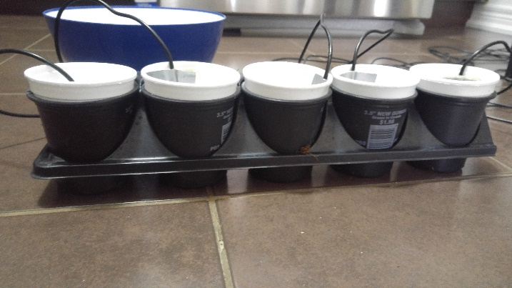
Plan
Primary Data
Simplified work by using electronics
2.5 ounces of water
5 cups at a time
This one also used to aid in warming the water to right temperature
This one isn’t taped on purpose
Probes

Slide 6
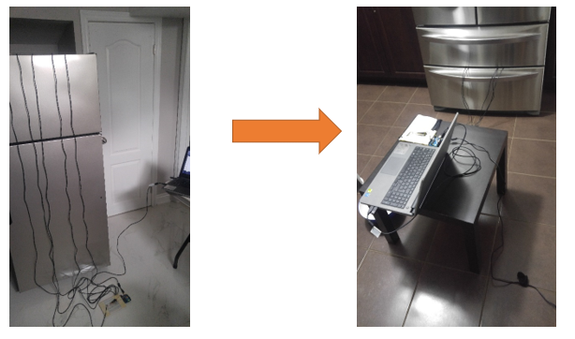
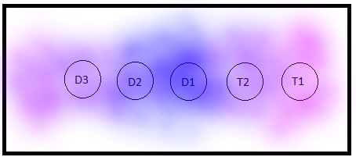
Problems With My Setup
First I used an old fridge (not good)
Half way through, noticed one cup consistently last one.

Slide 7
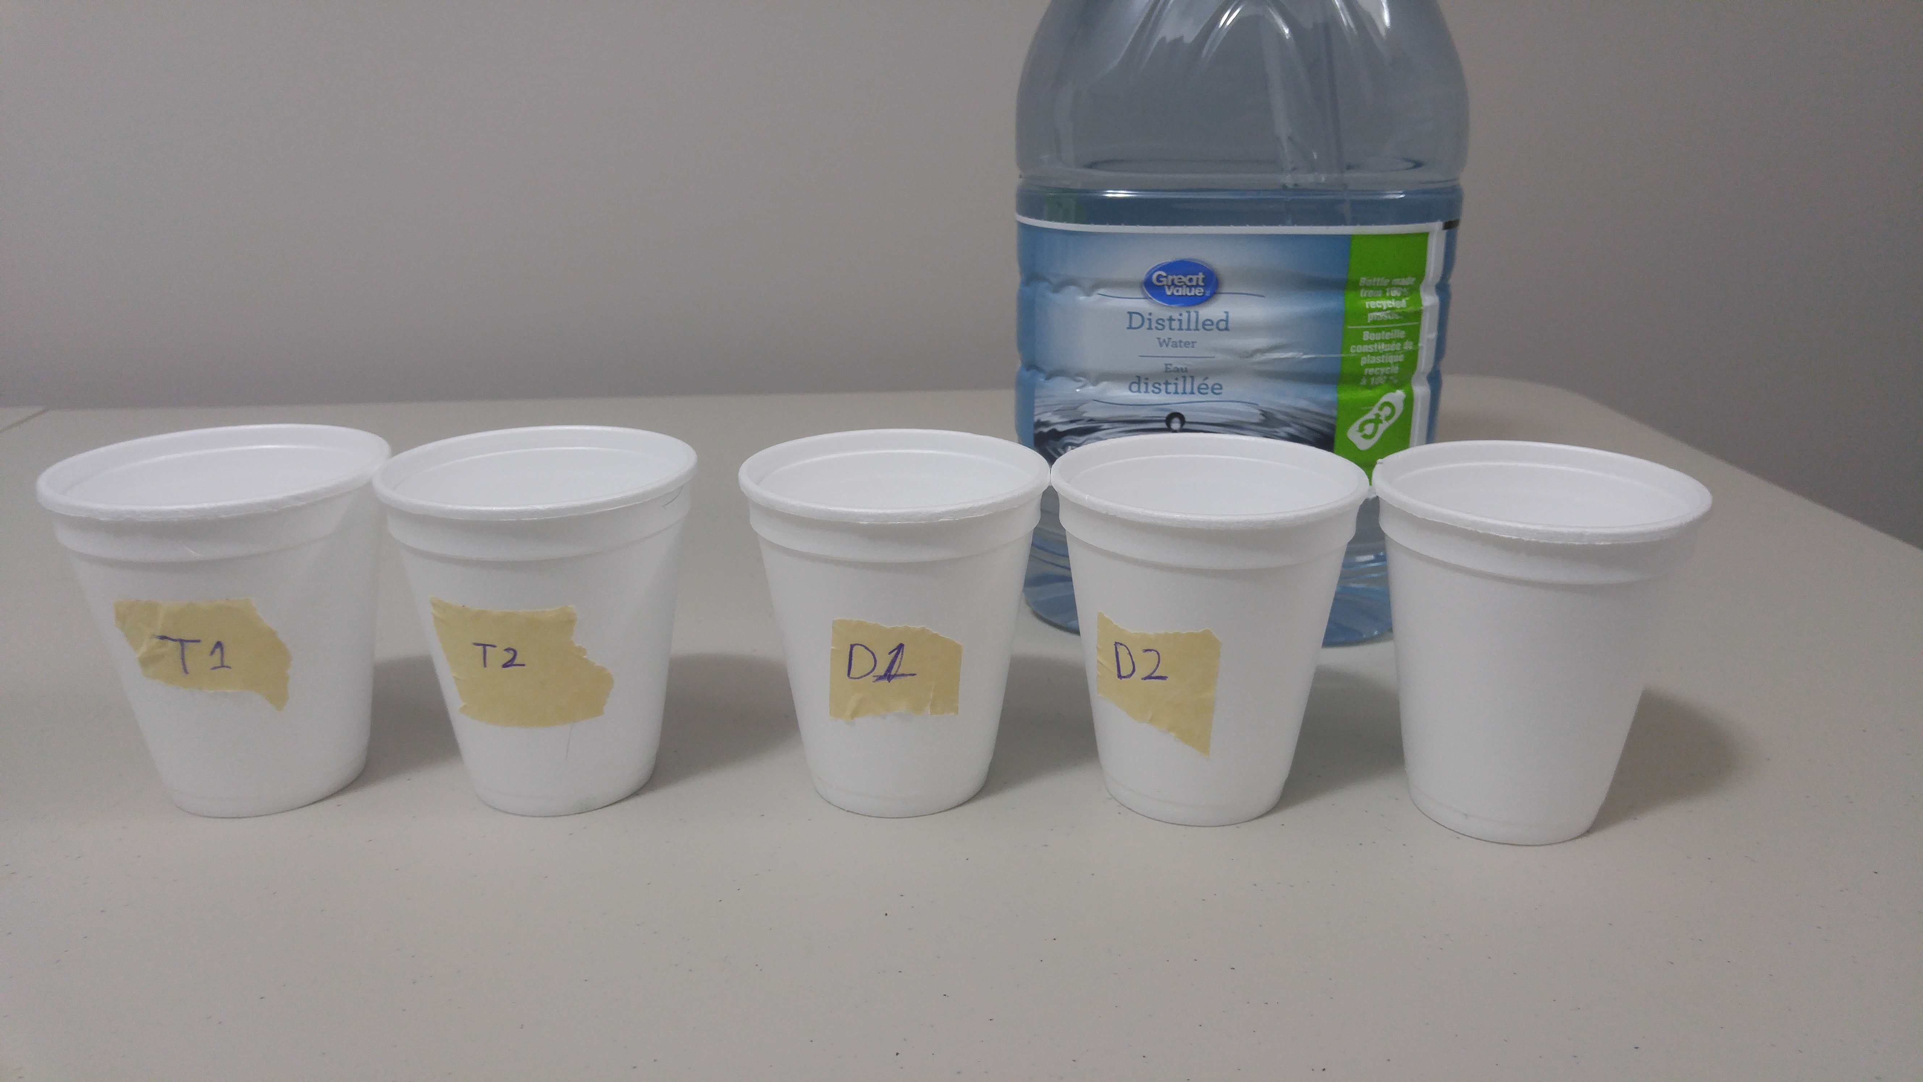
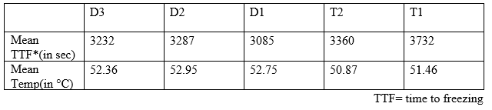
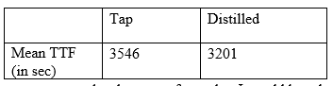
Analysis
Single variable analysis

Slide 8
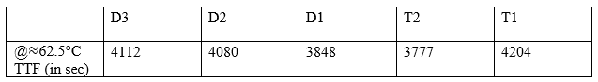
Analysis (continued)
Accidentally reversed the order for one trial:
T2 < D1 < D2 < D3 < T1
Used this mistake to measure bias.

Slide 9
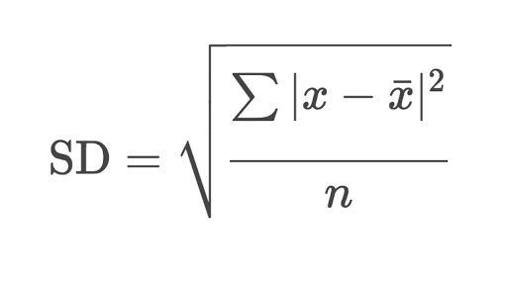
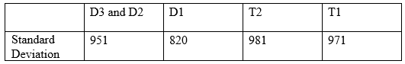
Analysis (continued)
Measure of spread
Standard deviation states level of confidence in average
Not too confident (average doesn’t represent much)
Used average temperatures and times for relative measurements (so it good)

Slide 10
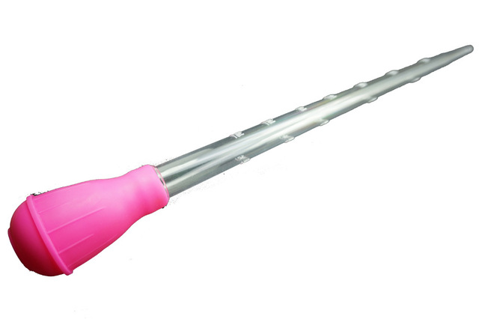
Water loss
Water loss was insignificant
Will have minimal impact on results
Evaporation is an endothermic process

Slide 11
Analysis (continued)
2 variable analysis:

Slide 12
Analysis (continued)

Slide 13
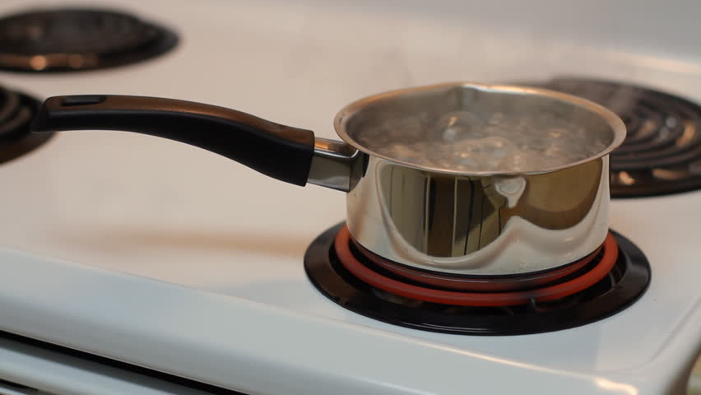
Analysis (continued)
Parabolic vs Logarithmic (which one)
Model Peaks around 90°C
Conclusion: TTF eventually does start reducing
But wait:
Not enough data above 90°C
Not enough data anyways (got divided)
Positioning and compression of the
parabola

Slide 14
Analysis (continued)

Slide 15
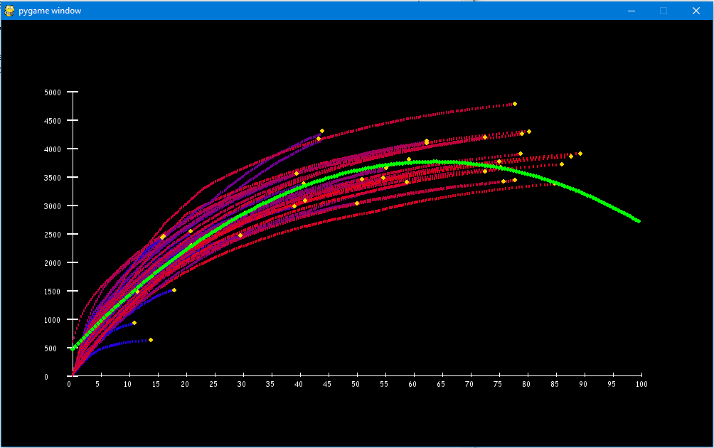
Main Secondary Question
The paradox
Every Logged Data Point for cup D2 and D3
y = -0.8133x² + 103.48x + 458.69
R² = 0.9013
Time to freezing (sec)
Registered Temperature (°C)

Slide 16
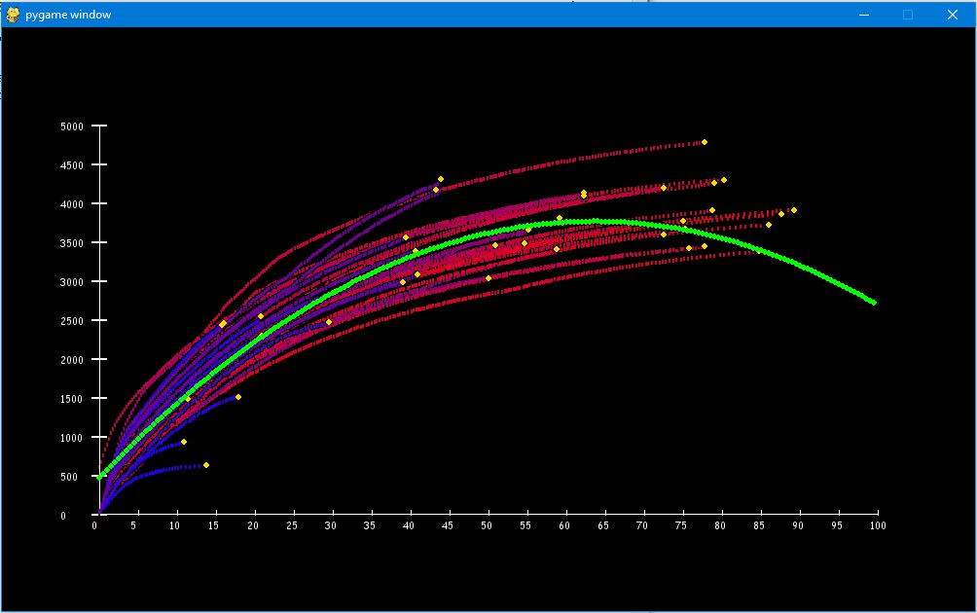
Main Secondary Question
The paradox
Every Logged Data Point for cup D2 and D3
y = -0.8133x² + 103.48x + 458.69
R² = 0.9013
Every Logged Data Point for cup D2 and D3
Time to freezing (sec)
Time to freezing (sec)
Registered Temperature (°C)
Registered Temperature (°C)

Slide 17
Conclusion
Experiment suggests Mpemba effect might be real (at least experiment cannot dismiss its existence)
Other initial conditions show more significant results
Water loss is insignificant.
Rate of cooling (hotter sample tend > rate colder sample) at any given temperature
Tap water froze slower than distilled water (ignored)

Slide 18

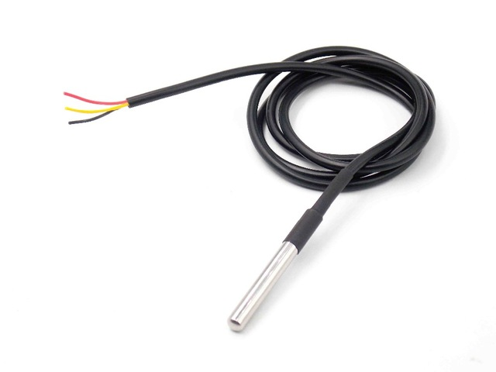
Bias and Limitations
Initial position of cups produced discrepancies.
Sensors have slight calibrations
Measurements limited to under 90°C

Slide 19
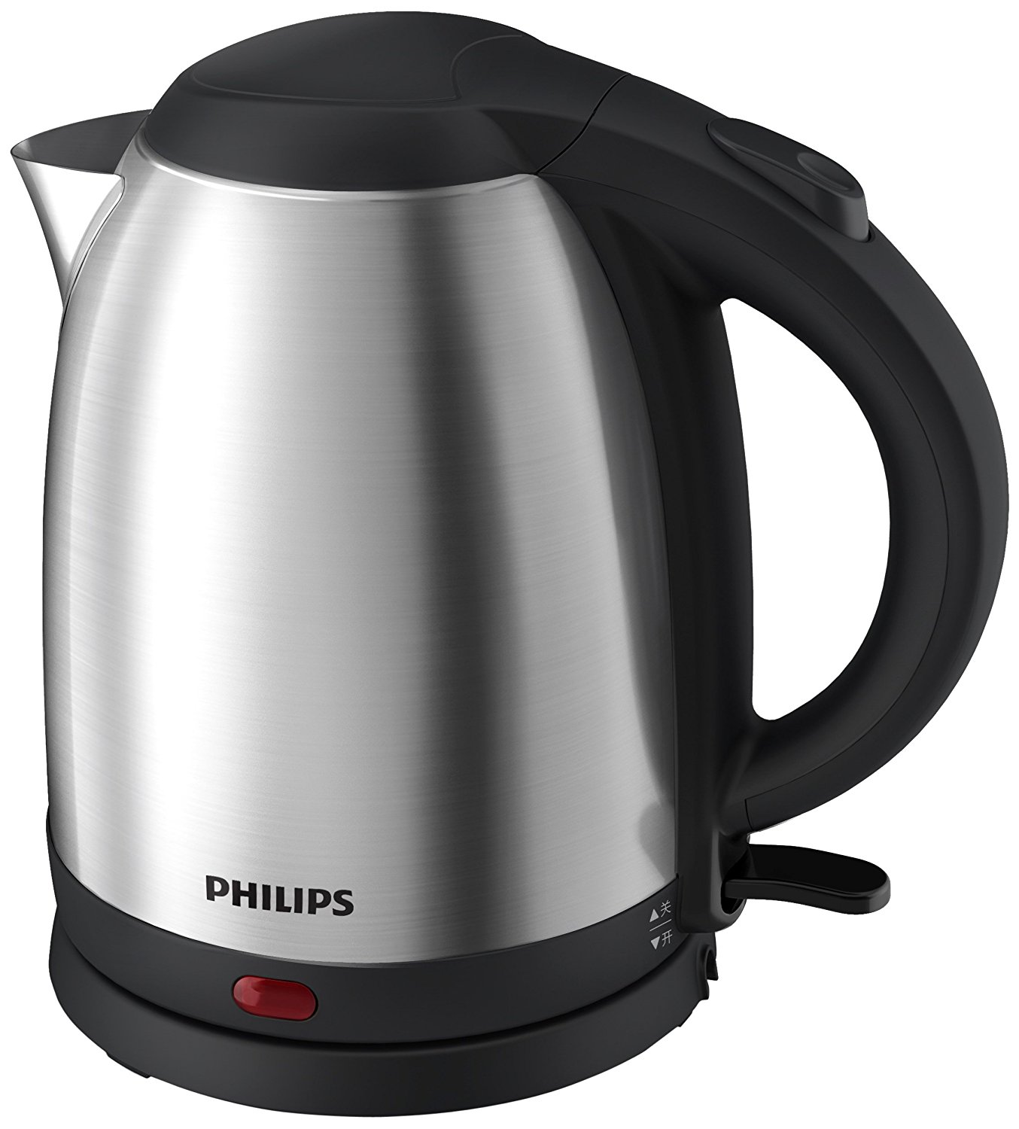
Future Improvements
Simplest improvement to run only one test at a time.
Always is same position
Same sensor being used
Drawbacks: Very time consuming
Buy an electric kettle to reach the 90°C + temperatures

Slide 20
Any Questions?

Slide 21
Bibliography
Jeng, M. (2006). The Mpemba effect: When can hot water freeze faster than cold? American Journal of Physics,74(6), 514-522. doi:10.1119/1.2186331
Mpemba, E. B., & Osborne, D. G. (1979). Cool? Physics Education,14(7), 410-413. doi:10.1088/0031-9120/14/7/312

